Slide 1
end of the public health emergency and what it means
JUNE 24, 2023
Dr. Jennifer Tuteur
Deputy Chief Medical Officer, Medical Care Services
County of San Diego Health & Human Services Agency
Notes:
Title

Slide 2
END OF PHE ANNOUNCEMENTS
February 28, 2023
End of California’s COVID-19 State of Emergency
May 5, 2023
End of World Health Organization global health emergency
May 11, 2023
End of federal COVID-19 PHE declaration

Slide 3
DATES & TIMELINES FOR THE END OF THE PHE

Slide 4
COVID-19 Precautions
​ | Still Mandatory​ | Strongly Recommended​ | No Longer Mandatory​
Face Coverings​ | None | Encourage health care settings, particularly hospitals, psychiatric hospitals and long-term care facilities to develop their own policies and procedures for face coverings | Universally (Facilities may require masking)​
Vaccinations​ | ​None | COVID-19 primary series for HCW COVID-19 boosters​ Flu vaccines for HCW | COVID-19 boosters beyond the primary series​
COVID Testing​ | Reporting positive and non-positive PCR tests​ | Testing all symptomatic persons and all asymptomatic persons with a known exposure​ | Testing everyone upon entrance to healthcare facilities​

Slide 5
COUNTY HEALTH OFFICER ORDERS
Changes Related to the End of Federal, State, and Local Emergencies
Vaccines will remain available.
Access to COVID-19 vaccines will generally not be affected for now. The U.S. government is currently distributing free COVID-19 vaccines for all adults and children.
COVID-19 at-home tests may not be covered by insurance.
Insurance providers will no longer be required to waive costs or provide free COVID-19 tests. CDC’s No Cost COVID-19 Testing Locator can help people find current community and pharmacy partners participating in the Increasing Community Access to Testing (ICATT) program.
Treatments will remain available.
Medication to prevent severe COVID-19, such as Paxlovid, will remain available for free while supplies last. After that, the price will be determined by the medication manufacturer and your health insurance coverage. Check with your healthcare provider if you need early treatment to prevent severe COVID-19.
National reporting of COVID-19 may change.
We have the right data for this phase of COVID-19 that will allow us to understand what’s happening with the virus in America in real-time. While what we have going forward will be different, it will still allow CDC, local public health officials, and the members of the public to understand COVID-19 dynamics at the community level.

Slide 6
SUMMARY OF PANDEMIC MEASURES

Slide 7
MULTIPLE DECLARATIONS IMPACT PANDEMIC RESPONSE

Slide 8
COVERAGE CHANGES WITH END OF THE PHE

Slide 9
MEDI-CAL REDETERMINATION
Medi-Cal continuous enrollment has ended.
ACTIONS:
Make sure San Diego's Self Sufficiency Dept. has the client's correct address
Complete redetermination packets on time
Medi-Cal Continuous Coverage Toolkit contains flyers, posters, call scripts, social media and email templates
Notes:
If the beneficiary's Medi-Cal is discontinued at the end of June 2023 because they didn't provide their Redetermination documentation, the individual will have until the end of September 2023 to provide documentation to restart their Medi-Cal.
If the individual has NOT completed the Redetermination Package by then, the individual will have to re-apply for Medi-Cal by completing a whole new application packet.

Slide 10
THERAPEUTICS TASK FORCE DEMOBILIZATION

Slide 11
HHS INTENT TO AMEND THE PREP ACT DECLARATION

Slide 12
SUMMARY OF PROCESS FOR EUA ISSUANCE

Slide 13
EUA AND THE END OF THE PHE

Slide 14
U.S. Drug Enforcement Agency (DEA) UPDATES
dea extending telemedicine flexibilities for prescribing controlled medications
NEW DEA TRAINING REQUIREMENT TAKES EFFECT JUNE 27, 2023
DEA is seeking approval from the White House to temporarily extend current COVID-19 Public Health Emergency (PHE) flexibilities for prescribing controlled substances via telemedicine.
All prescribers of Schedule II-V controlled substances must fulfil a single, eight-hour training requirement on identifying, treating and managing patients with opioid or other substance use disorders.

Slide 15
HHS END OF THE PHE FACT SHEET
Fact Sheet: End of the COVID-19 Public Health Emergency
What will not be affected by the end of the COVID-19 PHE:
Access to COVID-19 vaccinations and certain treatments, such as Paxlovid and Lagevrio
FDA’s EUAs for COVID-19 products (including tests, vaccines, and treatments)
Major telehealth flexibilities
Whole-of-government response to Long COVID

Slide 16
HHS END OF THE PHE FACT SHEET
Fact Sheet: End of the COVID-19 Public Health Emergency
What will be affected by the end of the COVID-19 PHE:
Certain Medicare and Medicaid waivers and broad flexibilities for health care providers are no longer necessary and will end
Coverage for COVID-19 testing will change, but USG is maintaining a strong stockpile and distribution channels so that tests remain accessible at no cost in certain community locations
Certain COVID-19 data reporting and surveillance
FDA’s ability to detect shortages of critical devices related to COVID-19 will be more limited
Public Readiness and Emergency Preparedness (PREP) Act liability protections will be amended

Slide 17
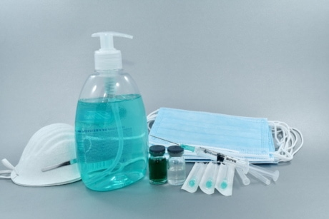
ADDITIONAL PHE RESOURCES
California Resources
Cal/OSHA COVID-19 Resources
California Medical Association COVID-19 Resources
Federal Resources
Current Emergencies Webpage| CMS
COVID-19 Therapeutics | HHS/ASPR
Interim Clinical Considerations for Use of COVID-19 Vaccines | CDC
FAQs: What happens to EUAs when a public health emergency ends? | FDA

Slide 18
COVID-19 TREATMENT & LONG COVID

Slide 19
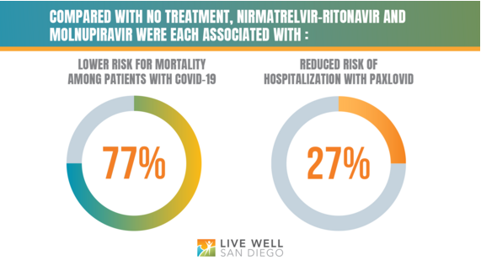
EFFECTIVENESS OF COVID-19 TREATMENT
Effectiveness of COVID-19 Treatment With Nirmatrelvir–Ritonavir or Molnupiravir Among U.S. Veterans: Target Trial Emulation Studies With One-Month and Six-Month Outcomes
Paxlovid (nirmatrelvir-ritonavir) and Lagevrio (molnupiravir) both associated with reduced mortality rates in COVID-19 patients
Both were each associated with a 77% reduced risk for death
Only Paxlovid was associated with a 27% reduced risk for hospitalization

Slide 20
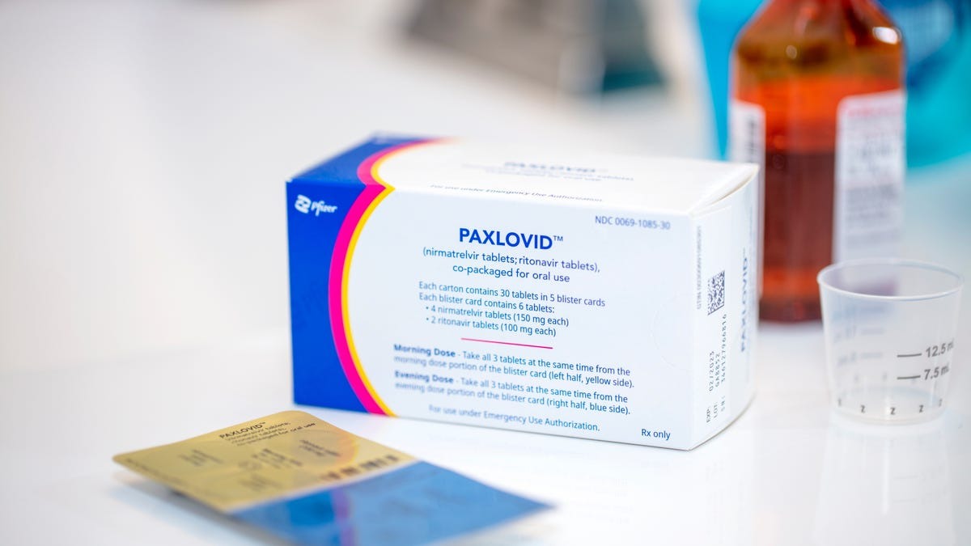
PAXLOVID AVAILABILITY
FDA Approves First Oral Antiviral for Treatment of COVID-19 in Adults
Paxlovid Prescribing Flyer
FDA approved Paxlovid (nirmatrelvir and ritonavir) for treatment of mild-to-moderate COVID-19 in adults at high risk for progression to severe COVID-19, including hospitalization or death
Paxlovid under EUA is available for treatment of eligible children ages 12-17 who are not covered by full approval
Not approved or authorized for use as a pre-exposure or post-exposure prophylaxis
Paxlovid supply is underutilized and available at no cost to eligible patients

Slide 21
RETURN TO WORK LONG COVID
6% of Omicron Infected conservatively estimated to develop Long COVID – 18% of infected not expected to return to work. (Currently only 50% full time back at work)
Long Covid Risk: Unvaccinated, not Paxlovid/molnupiravir treated, 2 or more COVID infections.
Etiology – “persisting immune dysregulation.” Long Term many sequalae unknown
Long COVID significant impact: families, spouses, children, employers, healthcare costs, income, economic recovery in setting of labor shortage – especially skilled workers.
Primary Care Healthcare providers – major source of care for Long COVID patients. Few specialized treatment centers with months long waiting lists.
BOTTOM LINE - Very Slow Graduated Back to work activity steps (NOT DO NOT COME BACK UNTIL 100%). Methods:
- Small stretch goals “baby steps” increasing activities
- Closely spaced return visits – Q other week, Once month
- Reasonable accommodations, when possible, from employer
- Patient maintains employer contact

Slide 22
RETURN TO WORK LONG COVID TREATMENT SUMMARY
Psychological Support
Listen and Validate – patients with guilt, depression, anxiety, PTSD
Symptom focused history – consider evaluation for existing complicating medical conditions based on history and physical…i.e. Shortness of Breath, Fatigue - CXR, Chest CT pulmonary angiography or MRI for consideration of continued pulmonary embolism/pulmonary fibrosis, PFTs for asthma/COPD.
no expensive multi system evaluations – especially as individuals may have limited insurance coverage.
Rehabilitation Regimen – LOW and SLOW GRADED EXERCISE i.e. 10-minute walking. Return to work beneficial to recovery.
Work Return – TITRATED GRADUAL INCREASE
- 4hrs – 3X week – M-W-F moving gradually to 4 hours – 4 days per week.
- Work from home option when possible – temporary status – appreciate workplace favoritism issues.
- Work environment – ideally self paced, quiet, avoid temperature extremes.
- No safety sensitive duties.
Patient Maintain COMMUNICATION with Employer – patient can share your letterhead updates with progress plan if desired.

Slide 23
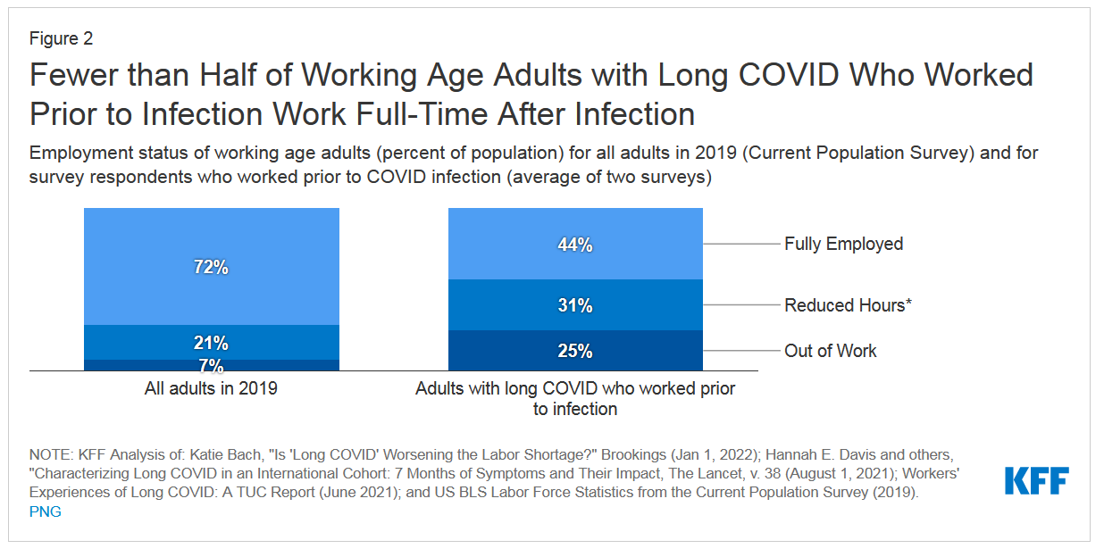
LONG COVID WORK IMPACT
What are the Implications of Long COVID for Employment and Health Coverage? | KFF

Slide 24
LONG COVID TREATMENT OVERVIEW
Step 1: In depth interview with
psychosocial support
Step 2: Evaluate for serious and/or
common conditions
Step 3: Targeted Evaluation
CARDS/PULM/PSYCH/NEURO
Step 4: Rehabilitation
CDC Telebrief 15 June 2023

Slide 25
LONG COVID PSYCHOSOCIAL SUPPORT
STEP 1: PSYCHOSOCIAL SUPPORT
Patients feel "abandoned”
Guilty/self doubt
Clinical depression/anxiety/PTSD
Listen and validate
Li Z, Zheng C, Duan C, et al. Rehabilitation needs of the first cohort of post-acute COVID-19 patients in Hubei, China. Eur J Phys Rehabil Med. 2020;56(3):339-344

Slide 26
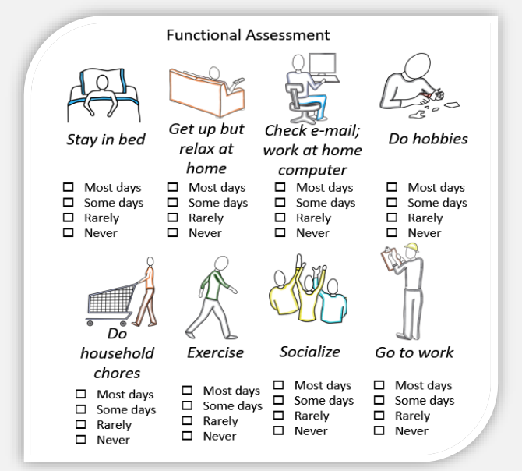
LONG COVID FUNCTIONAL ASSESSMENT
CDC Telebrief 15 June 2023

Slide 27
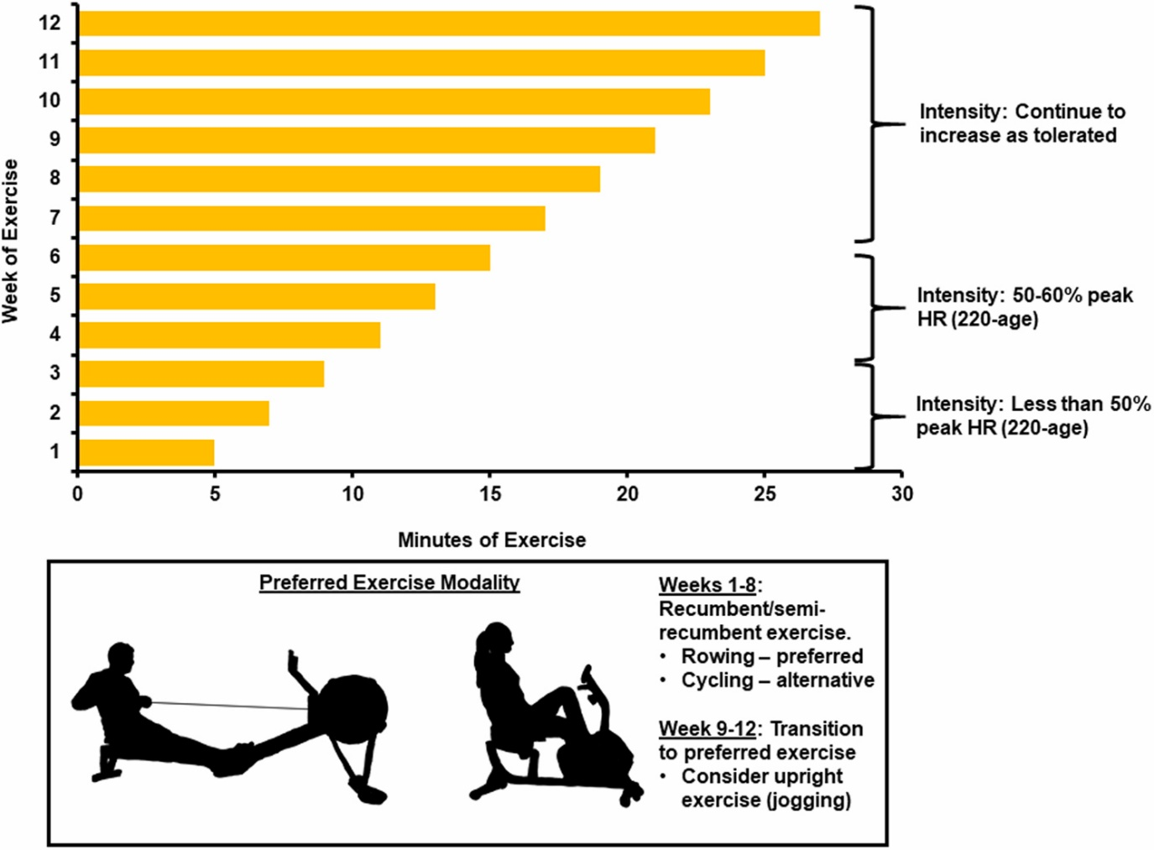
EXERCISE AS TREATMENT FOR LONG COVID
An Exercise Prescription as a Novel Management Strategy for Treatment of Long COVID
Case series of patients with long COVID whose symptoms improved/resolved with exercise and present exercise training as a novel therapeutic strategy for management of long COVID syndrome
Exercise improves quality of life and functional capacity among patients with POTS, CFS, and cardiac deconditioning and may also lead to improvement in symptom severity of long COVID

Slide 28
OCCUPATIONAL SAFETY CONCERNS

Slide 29
THANK YOU
Questions?

